Slide 1

YOU’RE
ON MUTE!
A Device to Control M$ Teams

Slide 2
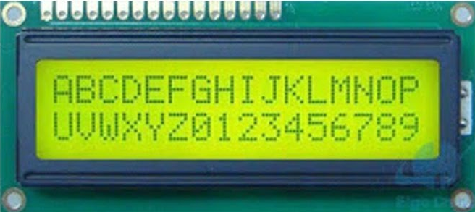



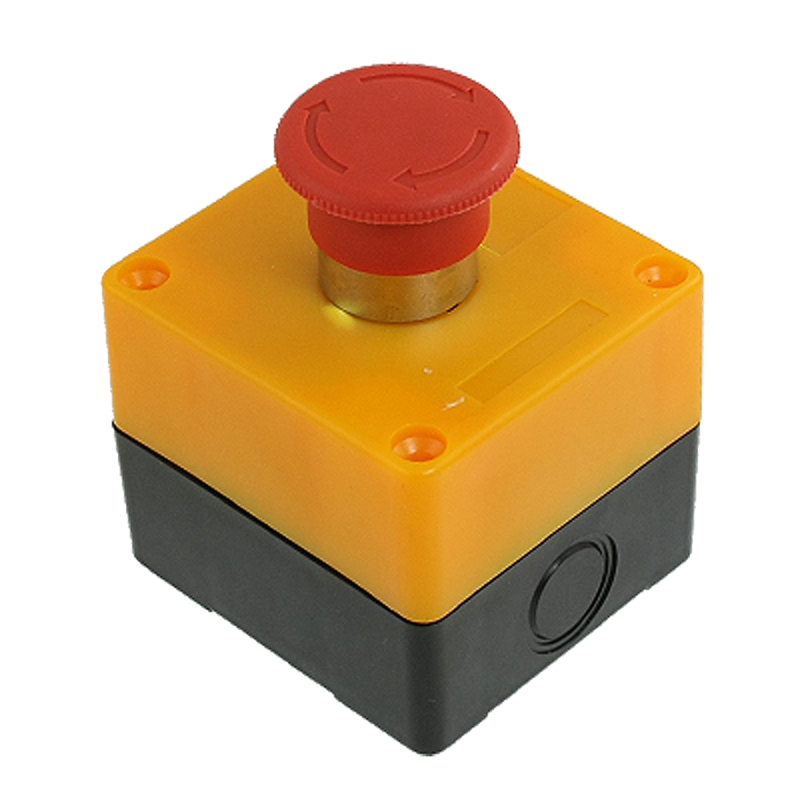
Components of the Solution
101010010101
Cycle
Windows
Toggle
Mute
Toggle
Camera

Slide 3
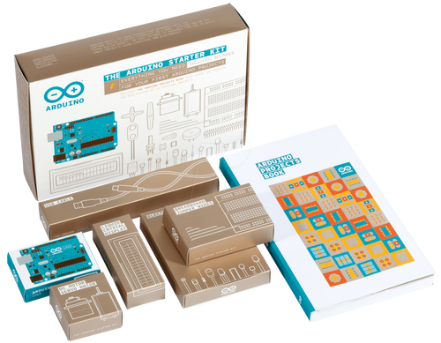
Arduino Starter Kit

